Slide 1
MIPS Tutorial 1

Slide 2
Program Structure
.data
var1: .word 4
.text
main:
lw $a0, var1
li $a1, 7
sw $a1, var1
lw $a0, var1
Variable declarations
Code
<number>/19

Slide 3
Data Types
Data types:
  instructions are all 32 bits
  byte(8 bits), halfword (2 bytes), word (4 bytes)
  a character requires 1 byte of storage
  an integer requires 1 word (4 bytes) of storage
<number>/19

Slide 4
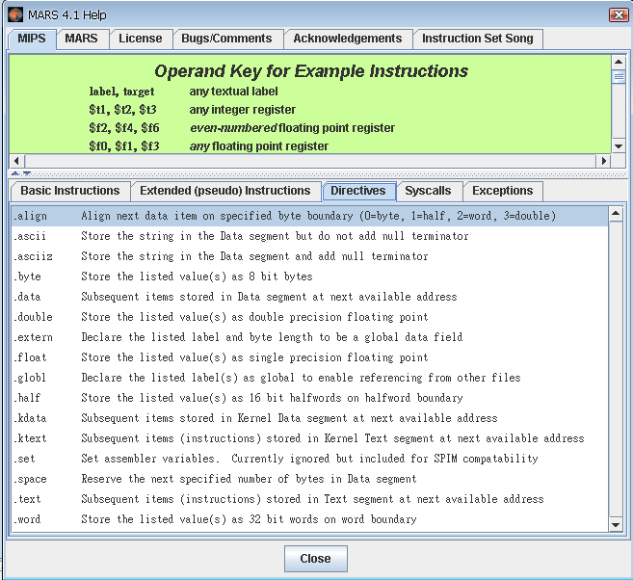
Variable Declaration
var1: .word 3 # create a single integer variable with initial value 3
array1: .byte 'a','b' # create a 2-element character array with elements
# initialized to 'a' and 'b'
array2: .space 40 # allocate 40 consecutive bytes, without initialization.
# 40-element character array, or
# 10-element integer array
<number>/19

Slide 5
Code
Load/Store Instructions
Arithmetic Instructions
Control Structures
System Calls and I/O
<number>/19

Slide 6
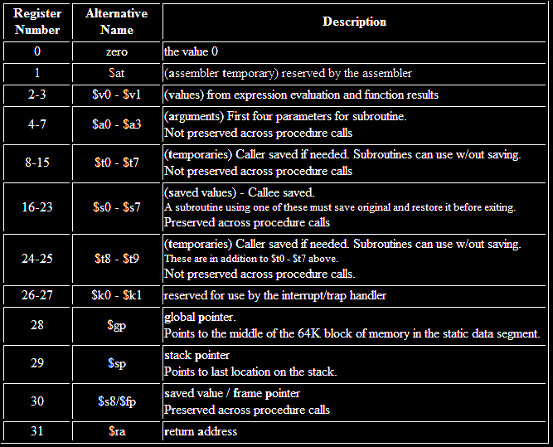
Register Conventions
<number>/19

Slide 7
Code
Load/Store Instructions
Arithmetic Instructions
Control Structures
System Calls and I/O
<number>/19

Slide 8
Load/Store Instructions
lw register_destination, RAM_source
lb register_destination, RAM_source
sw register_source, RAM_destination
sb register_source, RAM_destination
li register_destination, value
Access
Register
Memory
<number>/19

Slide 9
Example of Load/Store Instructions
#example:
.data
var1: .word 4
.text
main:
lw $a0, var1
li $a1, 7
sw $a1, var1
lw $a0, var1
var1
4
$a0
var1
4
4
$a1
7
var1
$a1
7
7
$a0
var1
7
7
<number>/19

Slide 10
Code
Load/Store Instructions
Arithmetic Instructions
Control Structures
System Calls and I/O
<number>/19

Slide 11
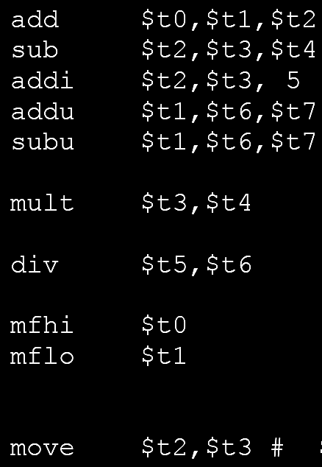
Arithmetic Instructions
3 operands for R-format instructions
All operands are registers
Operand size is one word (4 bytes)
Special registers
(Hi,Lo) = $t3 * $t4
Lo = $t5 / $t6
Hi = $t5 % $t6
<number>/19

Slide 12
Code
Load/Store Instructions
Arithmetic Instructions
Control Structures
System Calls and I/O
<number>/19

Slide 13
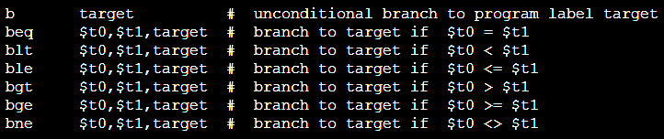
Control Instructions
Branch
Jump
<number>/19

Slide 14
Example of Control Instructions
.data
var1: .word 1
.text
main:
lw $t1, var1
li $t2, 1
beq $t1, $t2, THEN # if $t1 == $t2
li $t1, 2 # else $t1 = 2
ENDIF :
li $v0, 10
syscall # end program
THEN:
li $t1, 3 # then $t1 = 3
j ENDIF
If $t1 == $t2
Else
Then
$t1 = 2
$t1 = 3
End
<number>/19

Slide 15
Better Coding Style
.data
var1: .word 1
.text
main:
lw $t1, var1
li $t2, 1
IF:
bne $t1, $t2, ELSE # if $t1 != $t2
li $t1, 3 # then $t1 = 3
j ENDIF
ELSE:
li $t1, 2 # else $t1 = 2
ENDIF:
li $v0, 10
syscall # end program
If $t1 == $t2
Else
Then
$t1 = 2
$t1 = 3
End
<number>/19

Slide 16
Code
Load/Store Instructions
Arithmetic Instructions
Control Structures
System Calls and I/O
<number>/19

Slide 17
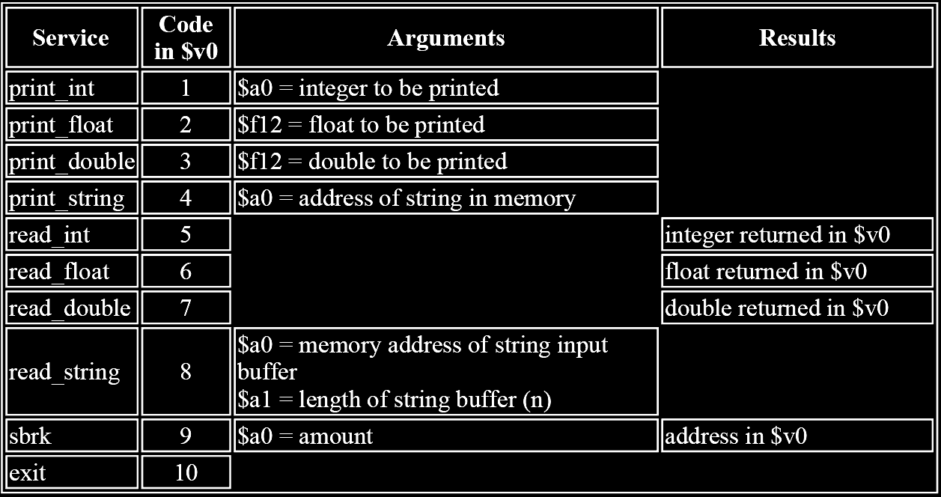
System Calls and I/O
Input and output system routine call
Set appropriate values in registers $v0 and $a0-$a1
Return value (if any) in stored in register $v0
<number>/19

Slide 18
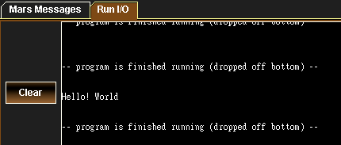
Example of Syscall
.data
string1: .asciiz "Hello! World\n\0"
.text
main:
li $v0 4
la $a0, string1
syscall
<number>/19

Slide 19
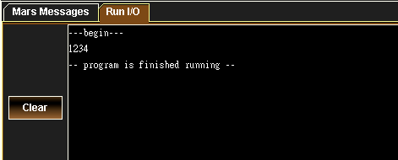
Example of loop
.data
begin: .asciiz "---begin---\n\0"
var : .word 0
.text
main:
li $t0, 4 # loop size
move $s0, $zero # loop counter
lw $t1, var # value
li $v0, 4 # print the value in $t1
la $a0, begin
syscall
loop:
addi $t1, $t1, 1 # increment value to be stored
li $v0, 1 # print the value in $t1
move $a0, $t1
syscall
addi $s0, $s0, 1 # loop control
bne $s0, $t0, loop
li $v0, 10 # system service 10 is exit
syscall
<number>/19

